Slide 1
Nord Quantique Internship summary
by Jean-Baptiste Bertrand

Slide 2
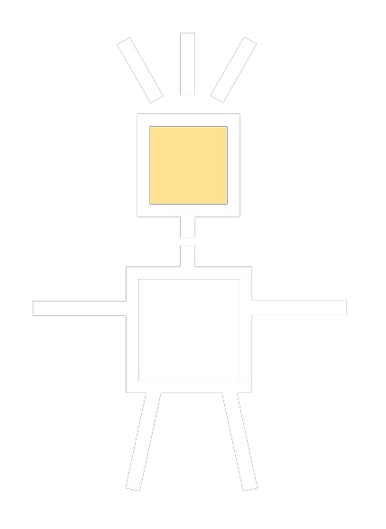




Smilarity to my master’s project
Simulate many GKP qubit using TN
ITensor
Quava

Slide 3
The main ideas of using Tensor Networks

Slide 4



A pictural representation introduced by Roger Penrose
i
rank n tensor n legged blob
j
T
T
T
A
i
d
T
a
c
b

Slide 5
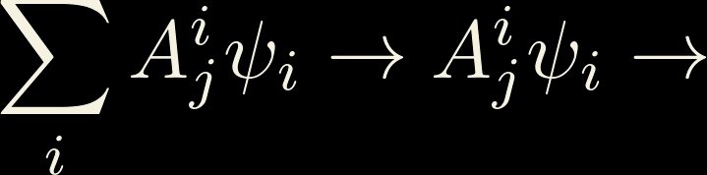


Examples
j
T
i
j
i
j
k
i
k
A
B
C
v
v
T

Slide 6
The goal in is to use less memory via powerful approximation

Slide 7


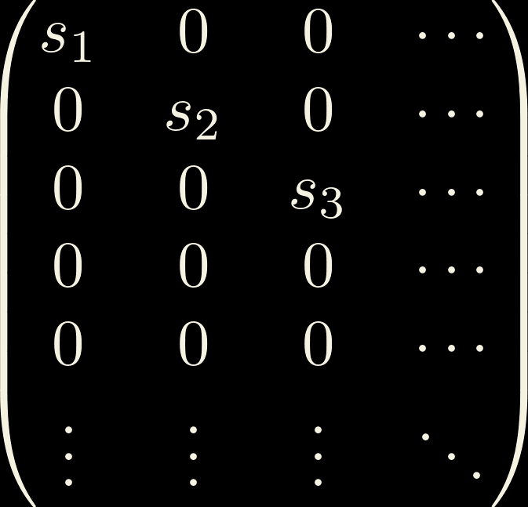
Singular Value Decomposition
Similar to a diagonalisation
Can be performed on any complex matrix, including rectangular ones
m
=
m
m
n
M
U
S
V
n
m
n
n
S
=
Uniquely defined when singular values are ordered in a specific way
Singular values are always real and positive

Slide 8





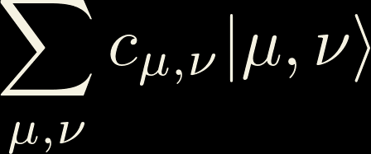
Splitting Hilbert space
i
E.g. :

Slide 9

Hilbert space is a small(er) place!
i
j
i
j
=
=
U
S
V
i
j
i
j
≈
U
V
=
U
V

Slide 10



Matrix Product States/Tensor Trains
i
j
i
j
j
i
i
=
=
U
S
=
U
V
U
V

Slide 11
Systems that are no too entengled
Schmidt decomposition
SVD
Singular values are the coefficient of Schmidth decomposition!
The size of the bond is the same thing as the number of coefficient in Schmidt decomposition!

Slide 12
Systems that are no too entangled
Very
fast
Very
Acurate

Slide 13
Using Tensor Network to do simulations

Slide 14
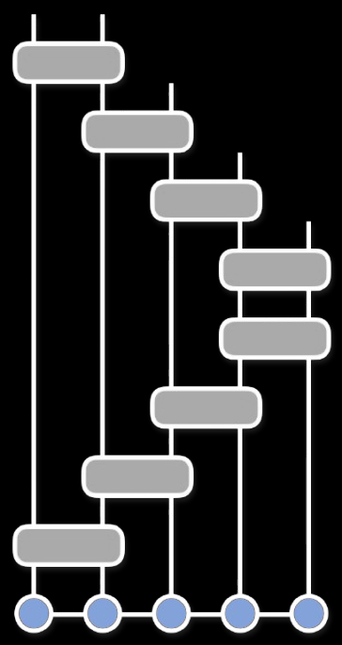
Tensor Networks are good at representing quantum circuits, not necessaraly quantum systems
sesolve
mesolve
time-evolving block decimation

Slide 15
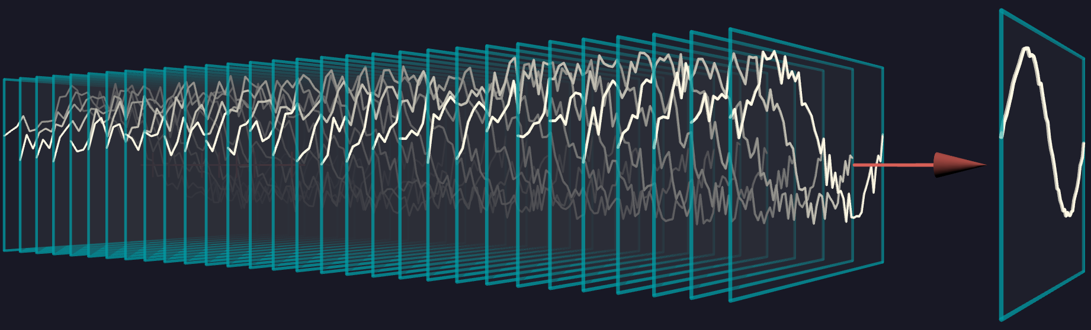
Using Monte Monte Carlo simulation

Slide 16
How to simulate interaction with the environement
E
E

Slide 17
How to simulate interaction with the environement
E
E
i

Slide 18
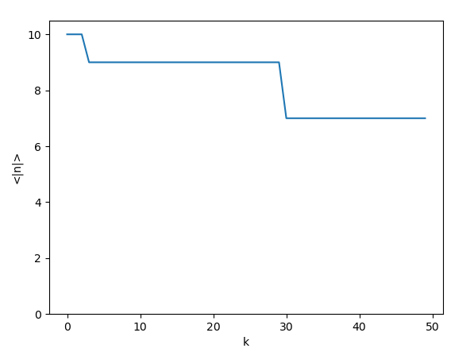
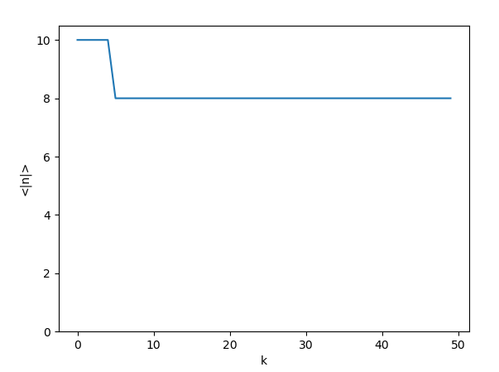
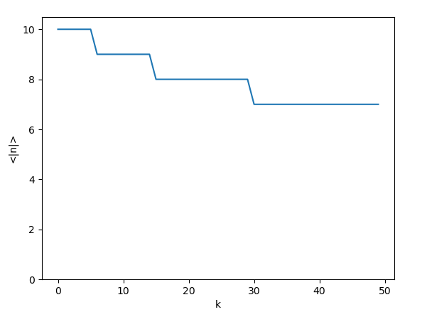
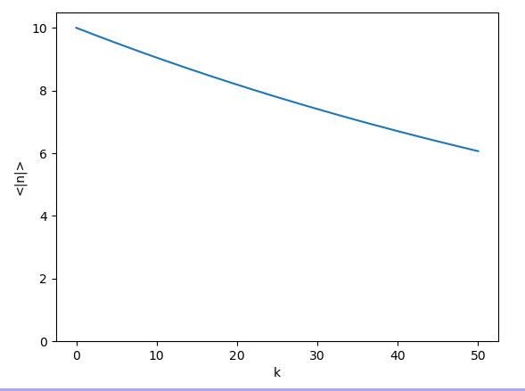
Example: photon loss
k times
Chosen randomly

Slide 19
More specific goal
More specific goal
- Build a tensor network based framework that can be built upon and serve as backend for quantum simulation
- Build on top of already defined states, operators and protocols
- Run multimode cavity state preperation simulation using the framwork to compare with current Nord Quantique software (Quava) and compare the performances of both methods

Slide 20
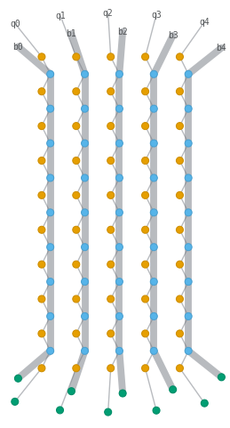
GKP and Tessaract state preperation

Slide 21
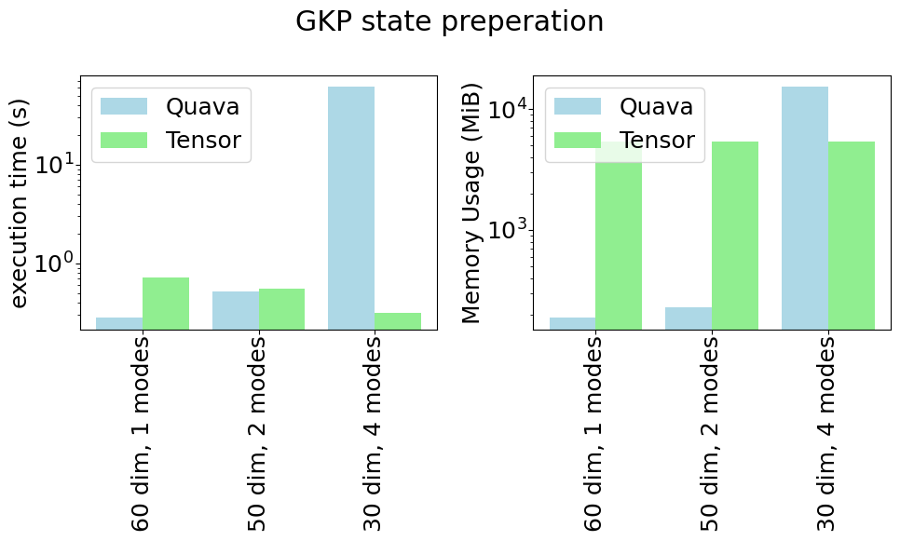
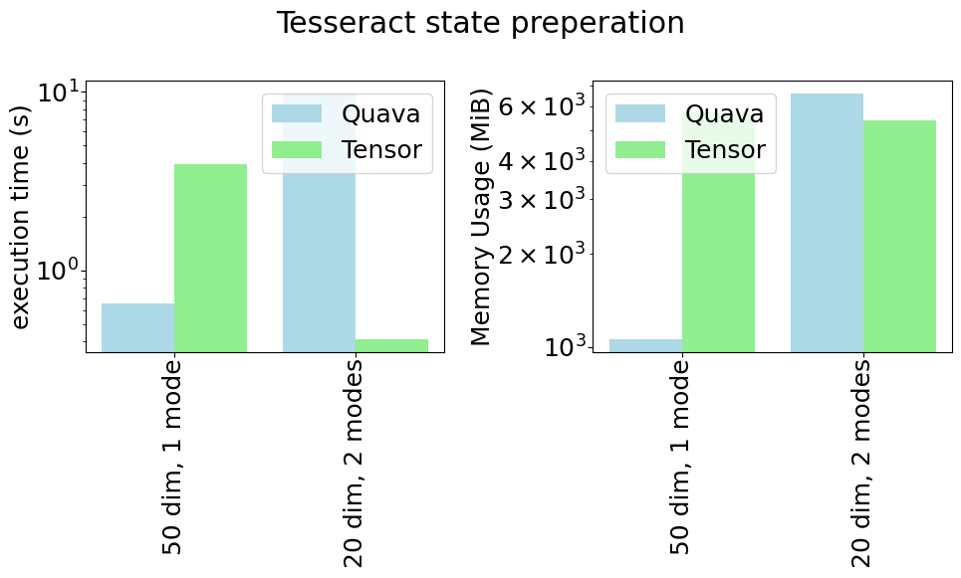
Performance results

Slide 22
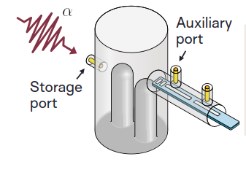
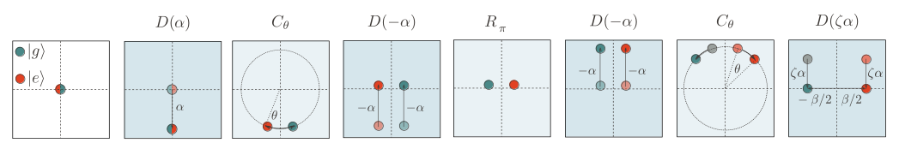
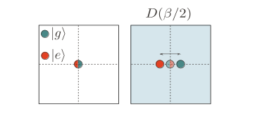
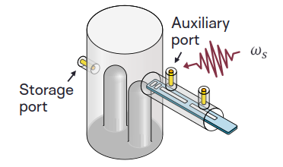
Transmon driven CD based stabilisation
n
Figures from Amélie Lacroix’s presentation

Slide 23
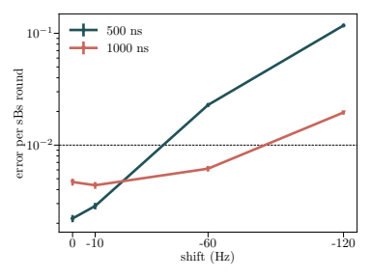
How good is it in the presence of non-linearties

